Slide 1


Database Systems
[Data Models, Schema and Data Independence]

Slide 2
Data Model is the modeling of the data description, data semantics, and consistency constraints of the data.
It provides the conceptual tools for describing the design of a database at each level of data abstraction.
Therefore, there are following four data models used for understanding the structure of the database:
Data Models
Data Models
Semi- structured Data Models
Entity- Relationship Data Models
Relational Data Models
Object-based Data Models

Slide 3
This type of model designs the data in the form of rows and columns within a table.
Thus, a relational model uses tables for representing data and in-between relationships.
Tables are also called relations. This model was initially described by Edgar
F. Codd, in 1969.
The relational data model is the widely used model which is primarily used by commercial data processing applications.
Relational Data Model:

Slide 4
An ER model is the logical representation of data as objects and relationships among them.
These objects are known as entities, and relationship is an association among these entities.
This model was designed by Peter Chen
and published in 1976 papers.
It was widely used in database designing. A set of attributes describe the entities.
For example, student_name, student_id
describes the 'student' entity.
A set of the same type of entities is known as an 'Entity set’, and the set of the same type of relationships is known as 'relationship set'.
Entity- Relationship Data Model:

Slide 5
An extension of the ER model with notions of functions, encapsulation, and object identity, as well.
This model supports a rich type system that includes structured and collection types.
Thus, in 1980s, various database systems following the object-oriented approach were developed.
Here, the objects are nothing but the
data carrying its properties.
Object-based Data Model:

Slide 6
This type of data model is different from the other three data models (explained above).
The semi-structured data model allows the data specifications at places where the individual data items of the same type may have different attributes sets.
The Extensible Markup Language, also known as XML, is widely used for representing the semi-structured data.
Although XML was initially designed for including the markup information to the text document, it gains importance because of its application in the exchange of data.
Semi-structured Data Model:

Slide 7
The data which is stored in the database at a particular moment of time is called an instance of the database.
The overall design of a database is called
schema.
A database schema is the skeleton structure of the database. It represents the logical view of the entire database.
A schema contains schema objects like table, foreign key, primary key, views, columns, data types, stored procedure, etc.
A database schema can be represented by using the visual diagram. That diagram shows the database objects and relationship with each other.
A database schema is designed by the database designers to help programmers whose software will interact with the database.
The process of database creation is called data
modeling.
Data model Schema and Instance

Slide 8
A schema diagram can display only some aspects of a schema like the name of record type, data type, and constraints. Other aspects can't be specified through the schema diagram.
For example, the given figure (next slide) neither show the data type of each data item nor the relationship among various files.
In the database, actual data changes
quite frequently.
For example, in the given figure (Next Slide), the database changes whenever we add a new grade or add a student.
The data at a particular moment of time is called the instance of the database.
Data model Schema and Instance

Slide 9
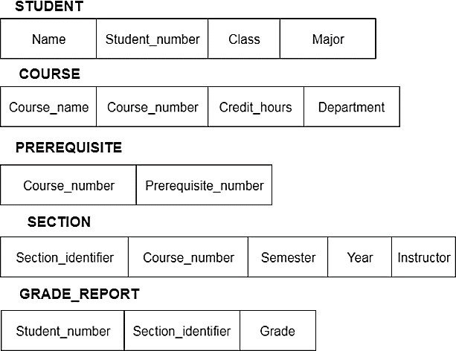
Data model Schema and Instance

Slide 10
Data independence can be explained using the three-schema architecture.
Data independence refers characteristic of being able to modify the schema at one level of the database system without altering the schema at the next higher level.
There are two types of data independence:
Logical Data Independence
Physical Data Independence
Data Independence

Slide 11
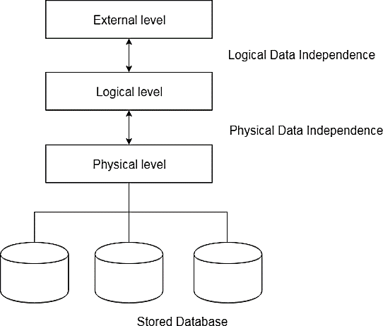
Data Independence

Slide 12
Logical data independence refers characteristic of being able to change the conceptual schema without having to change the external schema.
Logical data independence is used to separate the external level from the conceptual view.
If we do any changes in the conceptual view of the data, then the user view of the data would not be affected.
Logical data independence occurs at
the user interface level.
Logical Data Independence

Slide 13
Physical data independence can be defined as the capacity to change the internal schema without having to change the conceptual schema.
If we do any changes in the storage size of the database system server, then the Conceptual structure of the database will not be affected.
Physical data independence is used to separate conceptual levels from the internal levels.
Physical data independence occurs at the logical interface level.
Physical Data Independence

